Slide 1

Lending Club Case Study
Team : Gnanaprakash S and Vikas Sharma
Date : 06-09-2023

Slide 2
ASSIGNMENT Name: Lending Club Case Study
Problem Statement
Consumer finance company specializes in lending various types of loans to urban customers. When the company receives a loan application, the company has to make a decision for loan approval based on the applicant’s profile.
Two types of risks are associated with the bank’s decision:
If the applicant is likely to repay the loan, then not approving the loan results in a loss of business to the company
If the applicant is not likely to repay the loan, i.e. he/she is likely to default, then approving the loan may lead to a financial loss for the company
Assignment Objective
The aim is to identify patterns which indicate if a person is likely to default, which may be used for taking actions such as denying the loan, reducing the amount of loan, lending (to risky applicants) at a higher interest rate, etc.
Notes:
Problem Statement

Slide 3
PART I : Data Cleaning Analyzing Defaulted Applicants
There are 39717 rows and 111 columns present in the dataset.
Fix rows and columns:
Dropped the columns which are having more than 80% of invalid data.
Dropped the rows which are having more than 80% of invalid data.
Dropped the columns when it has less than 2 unique values.
Fix missing values:
Filling employee title with 'NaN' as 'Unknown'
Filling Homeownership with 'NONE' as 'OTHER'.
Results
Post cleaning there are 39717 rows and 44 columns are present
Notes:
Mention the results of the excel analysis and add the corresponding visualisations to the space provided above. Use copies of the above slide if necessary.

Slide 4
PART II: Data Analysis Analyzing Defaulted Applicants
Variable under consideration:
The 'Charged off' value in Column 'loan_status' refers to defaulted applicants.
Analyzing the driving factor for defaulting the loan applicants:
Based on analyzing the Meta data, removing the columns which are considered to be non-driving factor for defaulting the loan applicants
Out of 44 columns, these columns are considered to be non-driving factor [id", "member_id", "url", "title", "zip_code", "addr_state", "emp_title", "delinq_2yrs", "revol_bal", "out_prncp", "out_prncp_inv", "total_pymnt", "total_pymnt_inv", "total_rec_prncp", "total_rec_int", "last_pymnt_d", "last_pymnt_amnt", "last_credit_pull_d"]
Post droping out, we are having 26 columns [loan_amnt, funded_amnt, funded_amnt_inv, term, int_rate, installment, grade, sub_grade, emp_length, home_ownership, annual_inc, verification_status, issue_d, loan_status, purpose, dti, earliest_cr_line, inq_last_6mths, open_acc, pub_rec, revol_util, total_acc, total_rec_late_fee, recoveries, collection_recovery_fee, pub_rec_bankruptcies

Slide 5
PART III: Univariate Analysis Analyzing Defaulted Applicants
Variable under consideration:
Dropping the columns which do not affect the analysis - "id", "member_id", "url", "title", "zip_code", "addr_state", "delinq_2yrs", "emp_title", "revol_bal", "out_prncp", "out_prncp_inv", "total_pymnt", "total_pymnt_inv", "total_rec_prncp", "total_rec_int", "last_pymnt_d", "last_pymnt_amnt", "last_credit_pull_d“.
Convert all percentages to float type.
Filling the ‘revol_util’ column NaN values with Median.
Convert all time-series columns to Date-Time format.
‘sub_grade’ refers to Grade + Sub division value from grade, Updating the value with Sub division of it.
Categorizing the column for the Univariant Analyzing:
categorical_columns = ['term', 'emp_length', 'home_ownership', 'verification_status', 'purpose', 'inq_last_6mths', 'pub_rec', 'pub_rec_bankruptcies', 'grade' ]
numerical_columns = ['loan_amnt', 'funded_amnt', 'funded_amnt_inv', 'installment', 'annual_inc',
'dti', 'open_acc', 'total_acc', 'total_rec_late_fee', 'recoveries', 'collection_recovery_fee', 'int_rate_p', 'revol_util_p']
date_time_columns = [ 'issue_d' , 'earliest_cr_line' ]
Notes:
Mention the results of the excel analysis and add the corresponding visualisations to the space provided above. Use copies of the above slide if necessary.

Slide 6
PART II: Univariate Analysis Analyzing Defaulted Applicants
Variable under consideration:
Get the defaulted applicant.
Creating quartile bins for numerical columns to make them categorical.
Notes:
Mention the results of the excel analysis and add the corresponding visualisations to the space provided above. Use copies of the above slide if necessary.

Slide 7
PART III: Univariate Analysis (continue..)
Observations on Univariate Analysis:
Lower the loan_amnt increases the chance of defaulted - Range (500 - 7720.0)
Lower the funded_amnt increases the chance of defaulted - Range (500 - 7720.0)
Lower the installment increases the chance of defaulted - Range (15.69 - 279.27)
Lower the annual_inc increases the chance of defaulted - Range (4000.0 - 253264.0)
Between 40%-60% of the dti increases the chance of defaulted - Range (11.94 - 17.91)
Lower the open_acc increases the chance of defaulted - Range (2 - 9.2)
Between 20%-40% of the total_acc increases the chance of defaulted - Range (16.4 - 30.8)
Lower the total_rec_late_fee increases the chance of defaulted - Range (0.0 - 36.04)
Lower the recoveries increases the chance of defaulted - Range (0.0 - 5924.67)
Lower the collection_recovery_fee increases the chance of defaulted - Range (0.0 - 1400.43)
Between 40%-60% of the int_rate_p increases the chance of defaulted - Range (13.01 - 16.80)
Between 60%-80% of the revol_util_p increases the chance of defaulted - Range (59.94 - 79.92)
Higher chance of defaulted for " 36 months" in term column
Higher chance of defaulted for " 10+ years" in emp_length column
Higher chance of defaulted for " RENT" in home_ownership column
Higher chance of defaulted for " Not Verified" in verification_status column
Higher chance of defaulted for " debt_consolidation" in purpose column
Higher chance of defaulted for " 0" in inq_last_6mths column
Higher chance of defaulted for " 0" in pub_rec column
Higher chance of defaulted for " 0.0" in pub_rec_bankruptcies column
Higher chance of defaulted for " B" in grade column
Higher chance of defaulted for B grade of sub_grade " 5" column
Higher chance of defaulted on month 12 of year 1911 on issue_d column
Higher chance of defaulted on month 10 of year 1900 on earliest_cr_line column
Notes:
Mention the results of the excel analysis and add the corresponding visualisations to the space provided above. Use copies of the above slide if necessary.

Slide 8
PART IV : Bivariate Analysis Analyzing Defaulted Applicants
Variables under consideration:
categorical_columns = ['term', 'emp_length', 'home_ownership', 'verification_status', 'purpose', 'inq_last_6mths’, 'pub_rec', 'pub_rec_bankruptcies', 'grade']
numerical_columns = ['loan_amnt', 'funded_amnt', 'funded_amnt_inv', 'installment', 'annual_inc’, 'dti', 'open_acc', 'total_acc', 'total_rec_late_fee', 'recoveries’, 'collection_recovery_fee', 'int_rate_p', 'revol_util_p’].
Analyse ‘loan_amount’ with Interest rates.
Analyse ‘loan_amount’ with Home ownership.
Analyse ‘loan_amount’ with purpose.
Notes:
Mention the results of the excel analysis and add the corresponding visualisations to the space provided above. Use copies of the above slide if necessary.

Slide 9
PART IV : Bivariate Analysis Analyzing Defaulted Applicants
Variables under consideration:
Analyse ‘annual_income’ with loan amount.
Analyse ‘annual_income’ with home ownership.
Analyse ‘annual_income’ with employment length.
Analyse ‘annual_income’ with installment.
Analyse ‘annual_income’ with grades/sub-grades.
Notes:
Mention the results of the excel analysis and add the corresponding visualisations to the space provided above. Use copies of the above slide if necessary.

Slide 10
PART IV : Bivariate Analysis Analyzing Defaulted Applicants
Observations on Univariate Analysis:
Observations on Loan Amount:
Loan amount increases on Interest rate increses where more chance of Applicant movng under Defaults category.
High loan amount with applicant in MORTAGE have higher chance of Defaulted.
Loan amount with installment increases where the chance of defaults are higher.
Loan amount for 'Small business' purspose have high chance of defaults.
Observations on Loan Amount
Applicant with Annual income between (1203200.0 - 2402400.0) with higher loan_amnt have chance of defaulted.
Applicant with Annual income with home_ownership as MORTAGE has higher chance of defaulted.
Applicant with Annual income and having 10+ years of experience has higher chance of defaulted.
Applicant with Annual income between (1203200.0 - 2402400.0) with more installment have chance of defaulted.
Applicant with Annual income between (4080.0 - 1203200.0) with grade B and subgrade of 3-3.5 have chance of defaulted
Notes:
Mention the results of the excel analysis and add the corresponding visualisations to the space provided above. Use copies of the above slide if necessary.

Slide 11
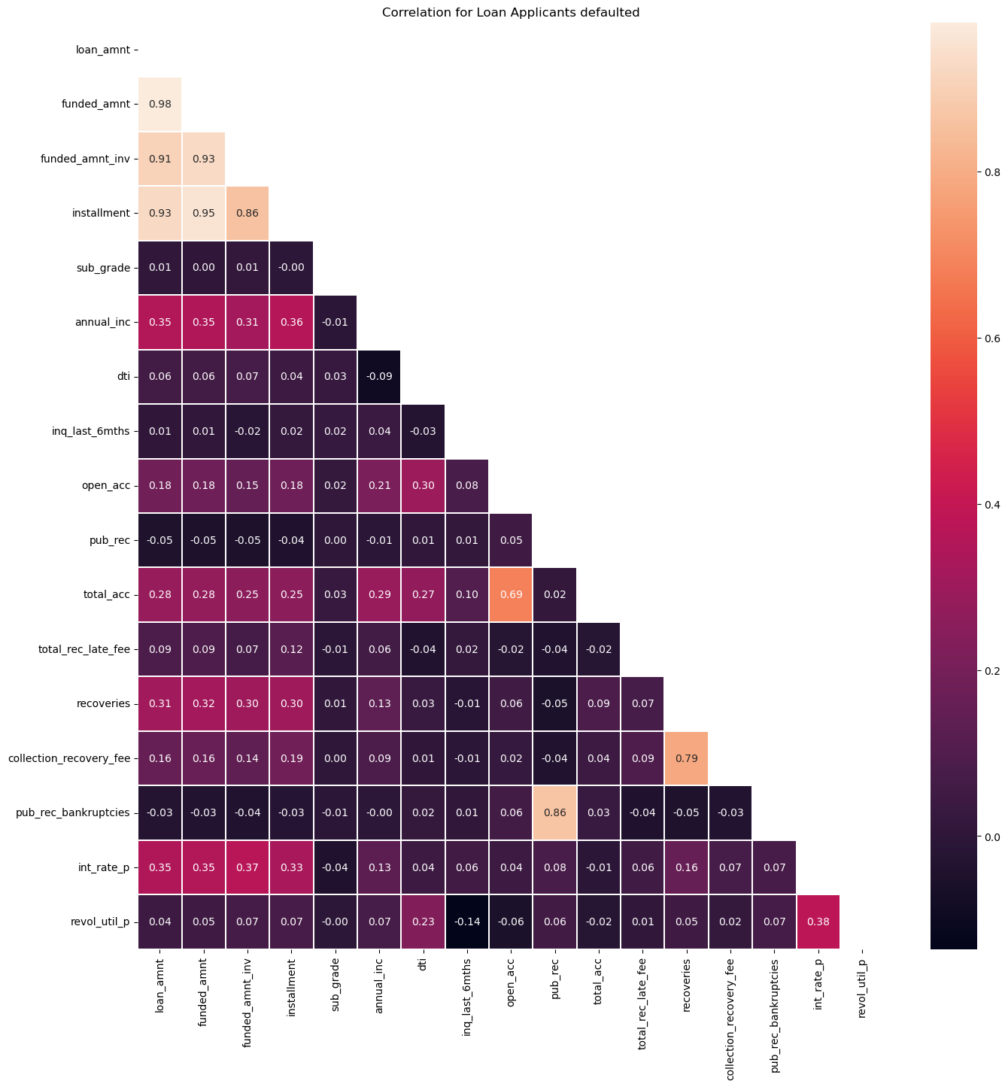
PART IV : Bivariate Analysis Analyzing Defaulted Applicants
Notes:
Mention the results of the excel analysis and add the corresponding visualisations to the space provided above. Use copies of the above slide if necessary.

